Slide 1
WELCOME
CALENDER PROJECT USING C

Slide 2
CALENDER PROJECT USING C BY Name: SAI DEEPIKA Reg.No: RA2111004010401 Branch: ECE Section: G section

Slide 3
WHAT IS CALENDAR?
WHY IS IT IMPORTANT TO US?
A chart or series of pages showing the days, weeks, and months of a particular year, or giving particular seasonal information
Calendars are useful tools for keeping track of upcoming meetings, deadlines, and milestones. They can help you visualize your schedule and remind you of important events, such as holidays and vacation time.
Calendars play an important role in our daily work to help us stay on task as well as be productive and prioritize

Slide 4
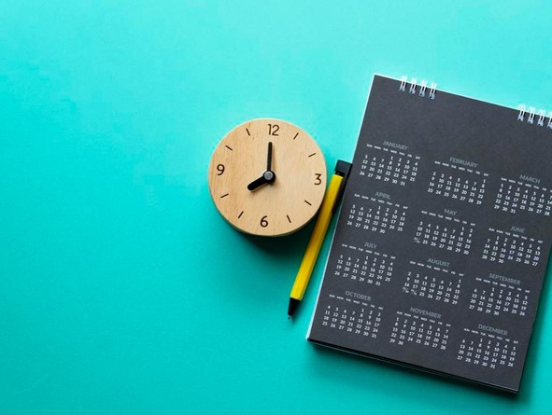
INTRODUCTION
THE CALENDAR APPLICATION CONSISTS OF DAYS, MONTHS AND YEARS
IT CAN BE WRITTEN AS DD- MM- YYYY FORMAT OR MM- DD- YYYY FORMAT.
USUALLY, MONTHS CONSIST OF 30 DAYS AND FEW CONSIST OF 31 DAYS AND EXCEPTIONALLY . FEBRUARY CONSISTS OF 28 DAYS AND 29 DAYS FOR EVERY FOUR YEARS WHEREAS WE CALL IT A LEAP YEAR.
THERE ARE SEVEN DAYS IN A WEEK, THEY ARE: SUNDAY, MONDAY, TUESDAY, WEDNESDAY, THURSDAY, FRIDAY AND SATURDAY
. THERE ARE 12 MONTHS AND THEY ARE: JANUARY, FEBRUARY, MARCH, APRIL, MAY, JUNE, JULY, AUGUST, SEPTEMBER, OCTOBER, NOVEMBER AND DECEMBER AND CONTAINS THE NTH YEAR.
A USER CAN ALSO ADD EVENTS AND REMAINDERS USING THIS SOFTWARE.
THIS CALENDAR APPLICATION IS BUILT USING C LANGUAGE.

Slide 5
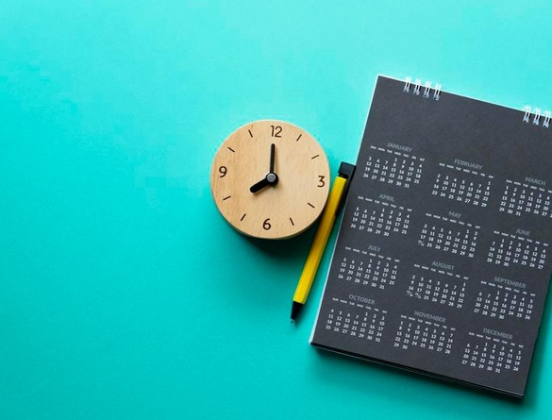
INTRODUCTION
IT IS BUILT WITHOUT USING GRAPHICS INSTEAD IT UTILIZES WINDOWS PROPERTIES.
THE ARRAYS AND STRINGS USED IN THIS APPLICATION HELPS USERS TO KNOW THE PARTICULAR DATE AND DAY IN THE PARTICULAR YEAR.
IT IS A SIMPLE DESIGNED APPLICATION AND IT DOESN’ T TAKE MUCH TIME TO OPERATE THE APPLICATION. THE IDE USED IN THIS APPLICATION IS DEV C++.

Slide 6
THE PRIMARY KEYS:
The keywords used in the program : int, void, case, switch, struct etc,
Loops : For , while (entry control loop)
Conditional Control structures: if , switch ,else , else if
Additional functions : GOTOXY(), COORD

Slide 7
STRUCT
It is a user defined datatype which creates a datatype that can be used to group items. It is used for dates and remainder
SWITCH
Allows to execute multiple operations for the different possible values and it is used to print number of days the name of the day and the name of the month
IF
If is included and also used to check whether the year passed is leap year or not
WHILE
while is used for entry control loop

Slide 8
OBJECTIVE
The aim of this project is to help the user to know the particular date and day in the particular nth year.
It allows the user to record events and add on remainders.
It also helps the user to manage the hectic schedule based on the time.

Slide 9
system requirements
SOFTWARE REQUIREMENTS:
LANGUAGE USED: C
OPERATING SYSTEM: WINDOWS 11
( MINIMUM REQUIREMENT: WINDOWS 7 )
HARDWARE REQUIREMENTS:
HARD DISK: 512 GB
PROCESSOR: I 5 PROCESSOR
( MINIMUM REQUIREMENT: I 3 PROCESSOR) IDE : DEV C++

Slide 10
ALGORITHM
START
STEP 1 : FIRSTLY IT STARTS WITH THE HOMEPAGE SHOWING
STEP 2 : USER NEEDS TO PROVIDE MONTH AND YEAR AS INPUT EXAMPLE: 08 2021 THIS DISPLAYS THE AUGUST CALENDAR FOR YEAR 2021
STEP 3 : THE APPLICATION DISPLAYS DAY CORRESPONDING TO A GIVEN DATE....
STEP 4 : IT ALSO DISPLAYS DAYS AND DATES CORRESPONDING TO A PARTICULAR MONTH AND YEAR....
STEP 5 : MONTHS CAN BE NAVIGATED USING ARROW KEYS. ALSO, ' N' AND ' P' KEYS CAN BE USED TO GO TO NEXT AND PREVIOUS MONTH RESPECTIVELY
STOP

Slide 11
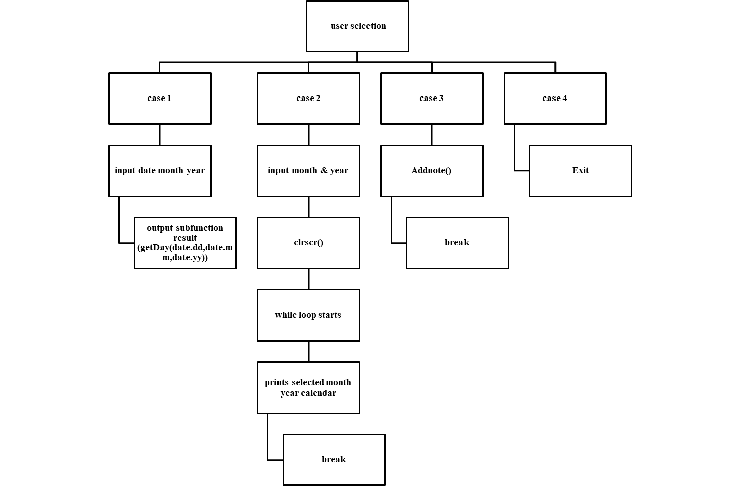
Block diagram

Slide 12
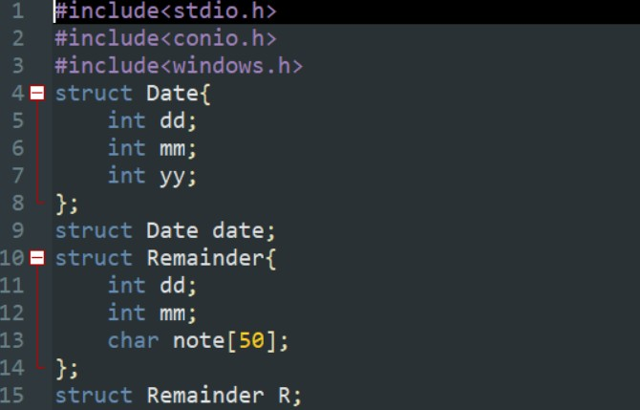
SYSTEM IMPLEMENTATION
I . MODULES AND FUNCTIONS I I . CODING
The code is a program that calculates the year of a given date.
The code starts by declaring variables for the date and remainder.
Then, it declares two structures: one structure is called "Date" which has three ints dd, mm, yy; and another structure is called "Remainder" which has an int dd and two char arrays note[] with 50 characters each.
The code also creates a remainder structure which is used to calculate the remainder of the date's year.

Slide 13
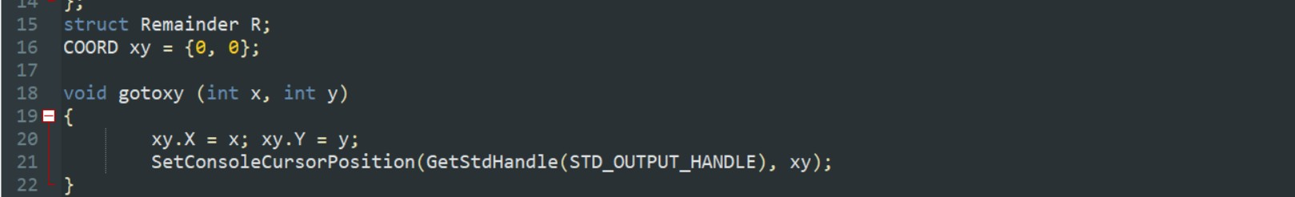
I . MODULES AND FUNCTIONS I I . CODING
◦
THE F I RST FUNCTION DECLARED I N THIS CODE I S GOTOXY().
THIS FUNCTION TAKES TWO PARAMETERS: X ( THE HORIZONTAL COORDINATE) AND Y ( THE VERTICAL COORDINATE).
I T SETS THESE COORDINATES TO 0 ON THE SCREEN THEN CALLS SETCONSOLECURSORPOSITION() TO
MOVE THE CURSOR TO THOSE COORDINATES

Slide 14
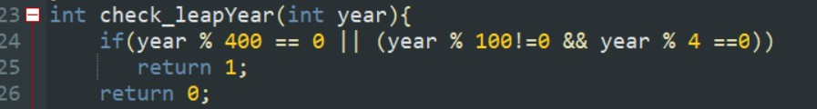
I . MODULES AND FUNCTIONS I I . CODING
- THE NEXT FUNCTION DECLARED I N THIS CODE I S CHECK_LEAPYEAR().
◦
- THIS FUNCTION RETURNS 1 I F YEAR % 400 == 0 OR I F YEAR % 100 ! = 0 && YEAR % 4 == 0 ; OTHERWISE I T RETURNS 0 . - THE CODE I S USED TO CREATE A DATE STRUCTURE.

Slide 15

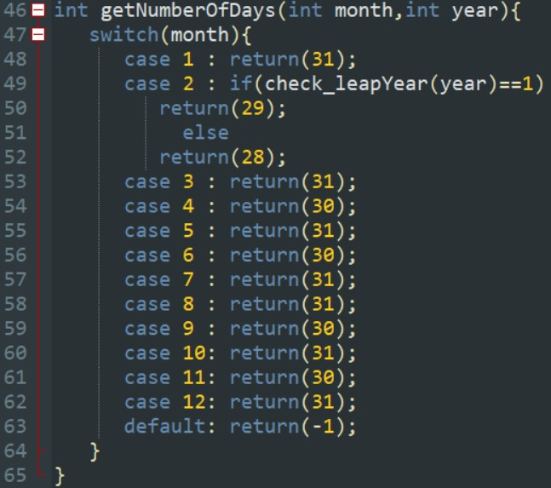
I . MODULES AND FUNCTIONS I I . CODING
The function getNumberOfDays() takes two parameters, month and year.
It then calculates the number of days in that month for that year by using switch-case statements.
◦
-The code is a function that takes two arguments: mm and yy.

Slide 16
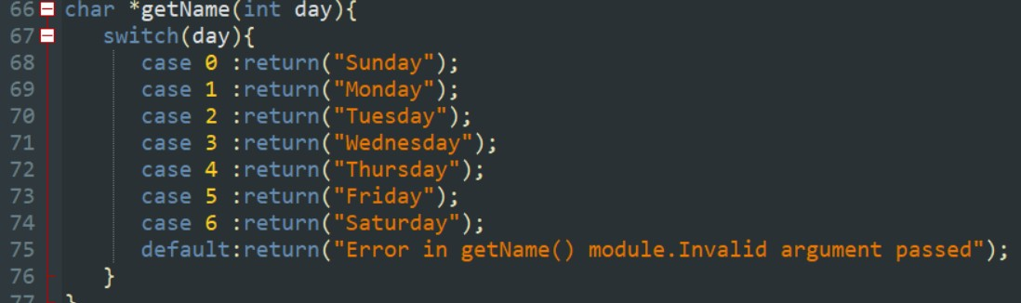
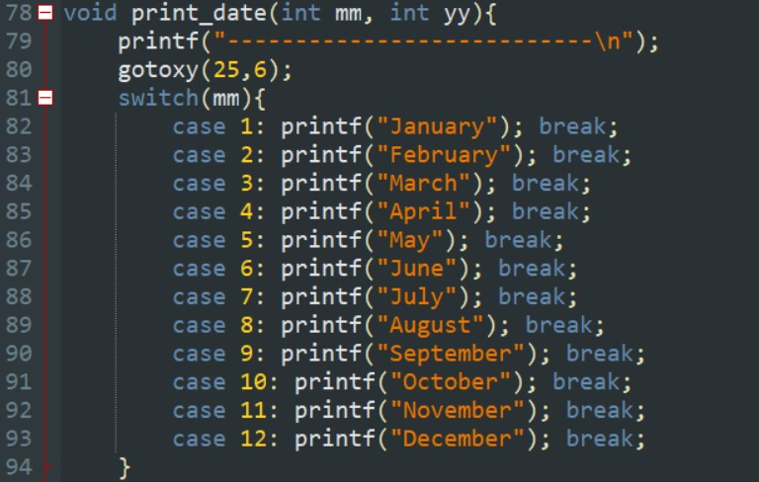
I . MODULES AND FUNCTIONS I I . CODING
◦

Slide 17

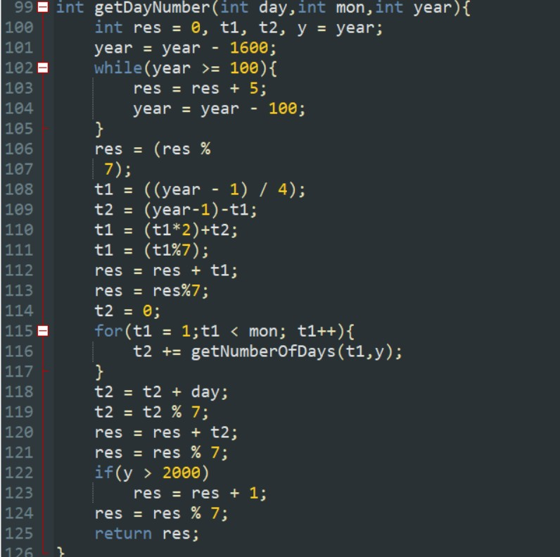
I . MODULES AND FUNCTIONS I I . CODING
I
The next line declares another variable called t1 which will be used later on for calculating days between two dates.
It also declares na variable called res which will be used later on for calculating days between two dates as well as checking whether or not there are any errors in calculations made by this function.
Finally, it calculates t2 using getNumberOfDays() and gets its value from 0-7 depending on what number you input into t1 (0=Sunday).
-The code is used to calculate the day number of a given month and year.
◦

Slide 18
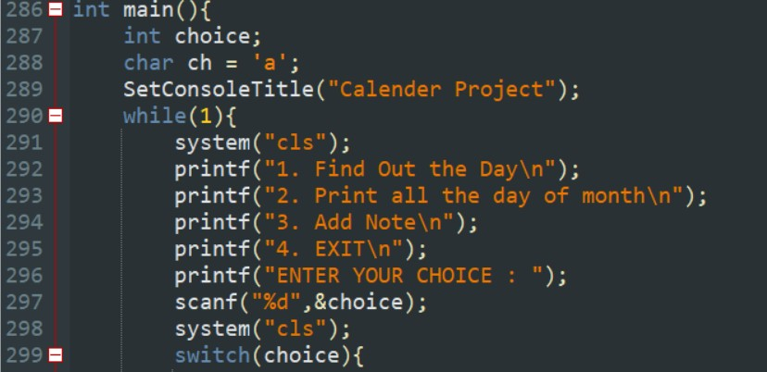
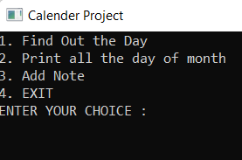
I . MODULES AND FUNCTIONS I I . CODING
OUTPUT
◦

Slide 19
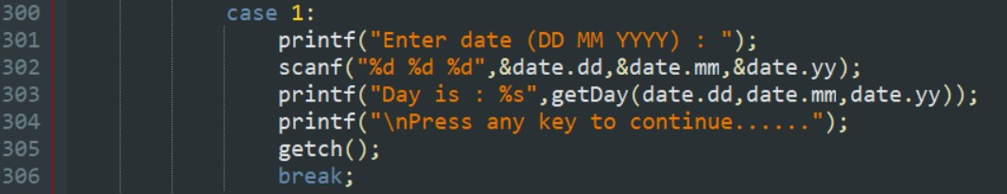
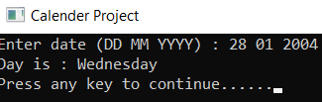
I . MODULES AND FUNCTIONS I I . CODING
Case 1:
OUTPUT
◦

Slide 20

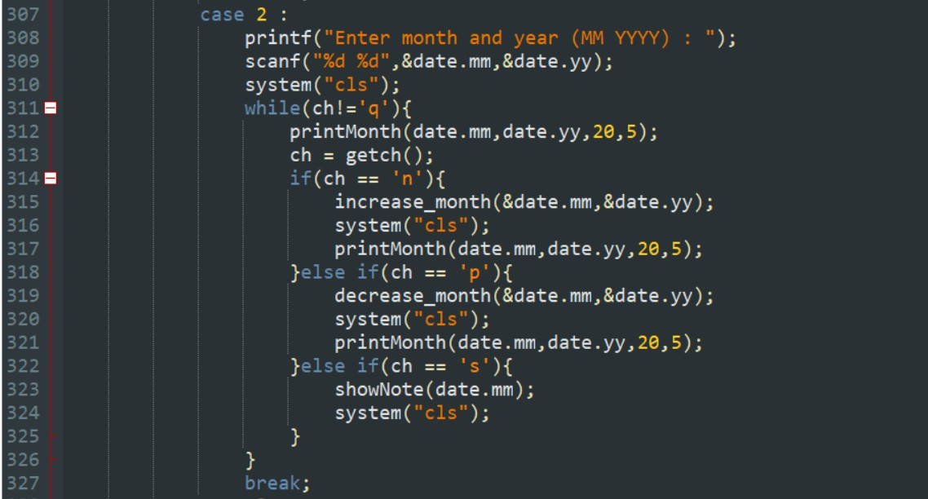
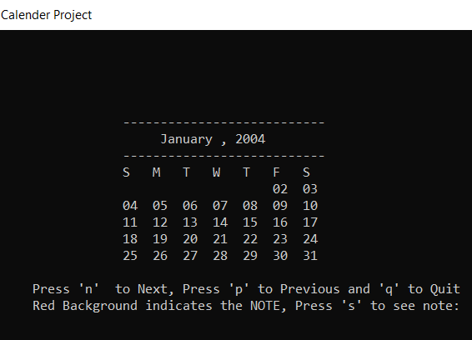
I . MODULES AND FUNCTIONS I I . CODING
Case 2:
OUTPUT
◦

Slide 21


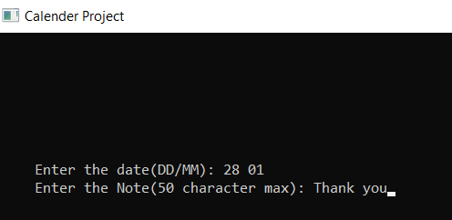
I. MODULES AND FUNCTIONS I I . CODING
Case 3:
OUTPUT
◦

Slide 22
Thank you

